Slide 1

'Planting for Drought'
Welcome everyone
Session 1
Why are we talking about drought?
Summer 2022

Slide 2


Why manage water?
Water is essential for the success and continuation of all our businesses. From the nursery and landscaper to the end-user, water is the life blood of our industry.
Without water:
Plant selection is influenced
Plants are placed under stress or die
The confidence of our clients to plant is influenced
The planting season may be restricted
The standards we achieve can be impacted
We are all at financial risk
We have an ethical and commercial responsibility to manage water.
Summer 2022

Slide 3

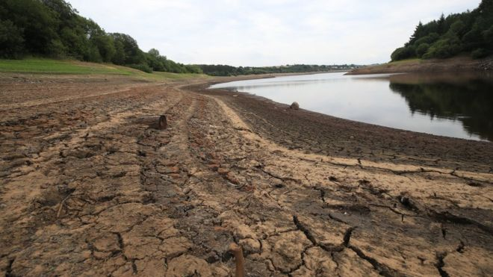
A vision of the future?
Within 25 years England will not have enough water to meet demand, the head of the Environment Agency is warning:
The impact of climate change, combined with population growth, means the country is facing an "existential threat", Sir James Bevan told the Waterwise Conference in London.
"We all need to use less water and use it more efficiently," he said.
Sir James Bevan was appointed chief executive of the Environment Agency - the public body responsible for protecting the environment and wildlife in England - in 2015 after a career as a diplomat.
He told his audience that, in around 20 to 25 years, England would reach the "jaws of death - the point at which, unless we take action to change things, we will not have enough water to supply our needs".
Source https://www.bbc.co.uk/news/uk-47620228 March 2019
Summer 2022

Slide 4

What is happening? Sun hours+
 | Eastbourne weather station
 | Sun hours
 | 1960 | 1970 | 1980 | 2016 | 2017 | 2018 | Average
January | 54.1 | 51.0 | 65.7.0 | 68.0 | 78.6 | 54.0 | 61.90
February | 103.0 | 130.7 | 59.0 | 75.2 | 51.7 | 144.6 | 94.03
March | 100.5 | 140.6 | 93.8 | 144.8 | 125.5 | 94.9 | 116.68
April | 185.9 | 138.8 | 193.4 | 192.8 | 217.5 | 170.8 | 183.20
May | 204.4 | 242.3 | 270.5 | 224.2 | 180.5 | 288.9 | 235.13
June | 257.3 | 309.5 | 250.0 | 144.7 | 241.2 | 291.2 | 248.98
July | 195.3 | 232.9 | 194.9 | 248.8 | 173.6 | 332.6 | 229.68
August | 225.7 | 222.0 | 202.4 | 235.6 | 208.3 | 208.8 | 217.13
September | 158.0 | 195.3 | 157.8 | 139.4 | 64.9 | 193.1 | 151.42
October | 122.1 | 128.5 | 131.0 | 116.8 | 83.0 | 164.6 | 124.33
November | 76.9 | 68.1 | 68.9 | 69.7 | 72.2 | 66.4 | 70.37
December | 46.9 | 58.0 | 74.2 | 60.7 | 51.2 | 49.5 | 56.75
Total | 1730.1 | 1917.7 | 1761.6 | 1720.7 | 1548.2 | 2059.4 | 1789.62
Summer 2022
https://www.metoffice.gov.uk/pub/data/weather/uk/climate/stationdata/eastbournedata.txt

Slide 5
What is happening? Rainfall-
 | Eastbourne weather station
 | Rainfall mm
 | 1960 | 1970 | 1980 | 2016 | 2017 | 2018 | Average
January | 82.0 | 119.9 | 67.0 | 167.8 | 102.3 | 83.9 | 103.82
February | 52.6 | 73.8 | 85.7 | 53.7 | 33.8 | 49.0 | 58.10
March | 80.5 | 45.7 | 102.9 | 45.1 | 19.0 | 80.5 | 62.28
April | 35.7 | 76.0 | 10.3 | 26.1 | 8.6 | 68.9 | 37.60
May | 70.4 | 34.0 | 44.5 | 44.2 | 51.4 | 39.2 | 47.28
June | 59.1 | 18.1 | 107.4 | 75.2 | 34.1 | 3.6 | 49.58
July | 60.2 | 59.5 | 155.7 | 5.0 | 77.5 | 30.8 | 64.78
August | 148.8 | 68.7 | 100.4 | 21.8 | 58.7 | 102.8 | 83.53
September | 66.5 | 113.8 | 48.6 | 21.6 | 85.1 | 36.0 | 61.93
October | 179.5 | 28.1 | 122.2 | 32.7 | 20.4 | 40.8 | 70.62
November | 218.8 | 209.9 | 56.4 | 69.5 | 35.1 | 159.6 | 124.88
December | 125.3 | 58.1 | 51.3 | 12.3 | 122.0 | 130.5 | 83.25
Total | 1179.4 | 905.6 | 952.4 | 575.0 | 648.0 | 825.6 | 847.67
Summer 2022
https://www.metoffice.gov.uk/pub/data/weather/uk/climate/stationdata/eastbournedata.txt

Slide 6

What is happening? Temp ºC+
 | Eastbourne weather station
 | Monthly Average Temp °C
 | 1960 | 1970 | 1980 | 2016 | 2017 | 2018 | Average
January | 7.4 | 7.5 | 6.3 | 9.9 | 7.8 | 9.7 | 8.10
February | 7.8 | 7.3 | 9.0 | 9.8 | 9.6 | 6.5 | 8.33
March | 9.0 | 7.8 | 8.7 | 10.6 | 13 | 8.4 | 9.58
April | 12.7 | 9.7 | 12.6 | 12.7 | 14.5 | 13.7 | 12.65
May | 16.2 | 15.8 | 15.6 | 17.0 | 17.4 | 18.4 | 16.73
June | 18.9 | 19.5 | 17.1 | 19.1 | 20.6 | 20.1 | 19.22
July | 18.4 | 18.4 | 18.0 | 21.2 | 21.9 | 24.6 | 20.42
August | 19.4 | 19.9 | 19.7 | 21.9 | 21.4 | 21.1 | 20.57
September | 17.6 | 18.4 | 18.6 | 21.3 | 18.9 | 18.5 | 18.88
October | 14.3 | 15.1 | 14.2 | 16.2 | 16.3 | 16.3 | 15.40
November | 11.8 | 12.1 | 9.5 | 11.9 | 11.4 | 12.2 | 11.48
December | 7.6 | 7.3 | 8.7 | 10.9 | 9.0 | 10.7 | 9.03
Summer 2022
https://www.metoffice.gov.uk/pub/data/weather/uk/climate/stationdata/eastbournedata.txt

Slide 7
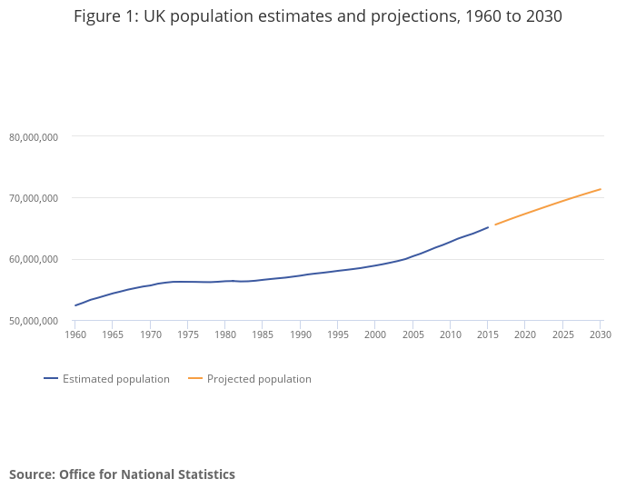
What is happening? Population
Summer 2022

Slide 8
'Planting for Drought'
Session 2
Characteristics of a drought tolerant plant
A selection of plants
Summer 2022

Slide 9
Plant groups – a guide
Some definitions:
Drought is a prolonged period of abnormally low rainfall, leading to a shortage of water.
Drought tolerance is the ability by which a plant maintains its structure and survival during arid or drought conditions. Some plants have adapted to dry conditions.
Drought tolerant plants can grow or thrive with minimal water or rainfall, some species in groups such as Ferns may dieback becoming dormant.
Drought resistant plants can survive for long periods of time without water.
Most plant groups have drought tolerant/resilient genera. Some groups such as bedding can be replaced with herbaceous plants that, once established, can be considered drought tolerant.
Summer 2022

Slide 10

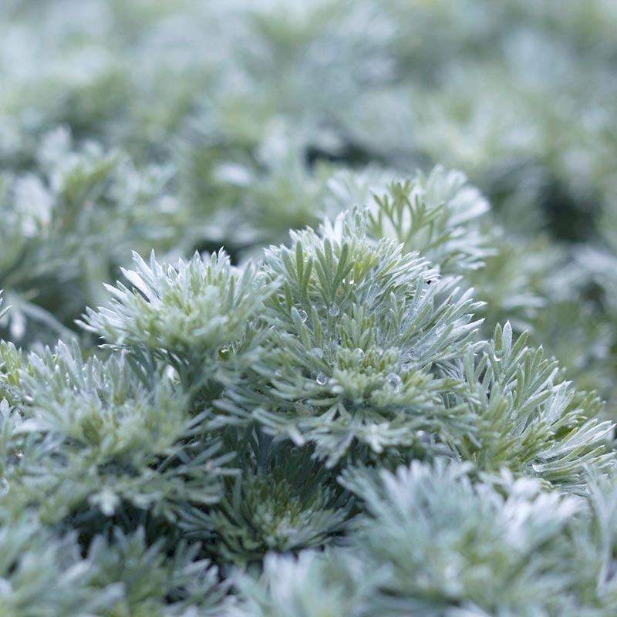
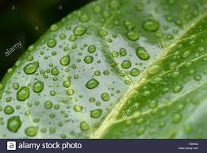
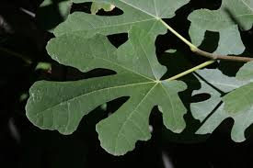
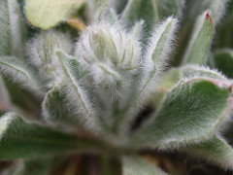
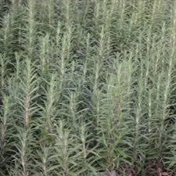
Plant characteristics
Drought tolerant plants have one or more of the following characteristics:
Adapted stems - Storing water
Deeply lobed leaves - Reducing surface area
Fine hairs on leaves or stems - Trapping moisture
Silver or grey-green leaves - Reflecting sunlight
Small or needle-like leaves – Reducing surface area
Waxy leaf surfaces – Reducing water loss & temperatures, reflecting light
As climate change challenges us,
plant selection becomes more important.
Summer 2022

Slide 11

A selection of genera
Drought tolerant genera
Abelia | Cercis | Geranium | Panicum
Acacia | Chamaecyparis | Halimium | Papaver
Achillea | Cordyline | Hebe | Passiflora
Alliums | Cortaderia | Helianthemun | Pennisetum
Anemanthele | Cupressus | Helichrysum | Perovskia
Anthemis | Cyclamen | Heuchera | Phlox
Arbutus | Delosperma | Hypericum | Pinus
Artemisia | Digitalis | Iris | Rosmarinus
Asclepias | Eccremocarpus | Jasminum | Salvia
Baptisia | Echinops | Juniperus | Santolina
Bergenia | Elaeagnus | Kniphofia | Sarcococca
Berlandiera | Eryngium | Koelreuteria | Sedum
Briza | Eucalyptus | Lavandula | Solanum
Buxus | Euphorbia | Lupinus (arboreus) | Spartium
Callistemon | Evening Primrose | Nandina | Stipa
Campanula | Festuca | Olearia | Thymus
Campsis | Ficus | Ophiopogon | Ulex
Ceanothus | Fremontodendron | Osteospermum | Verbascum
Centaurea | Gaillardia | Ozothamnus | Verbena
Summer 2022
Not all species within the genus can be considered drought tolerant.

Slide 12
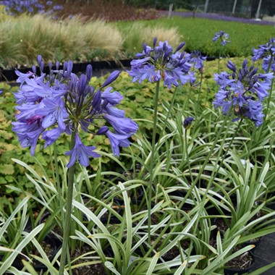
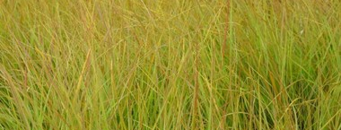
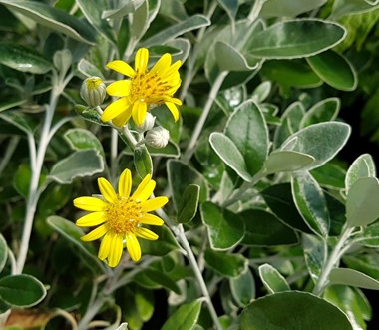
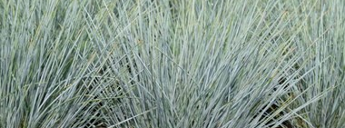

Slide 13
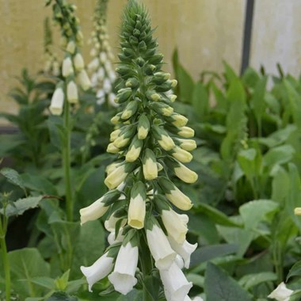
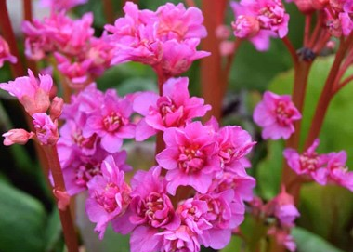
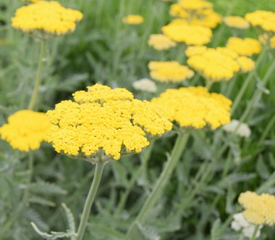
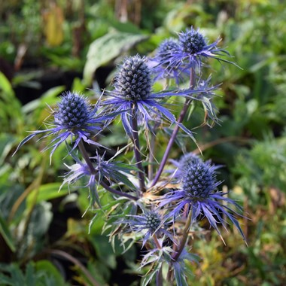
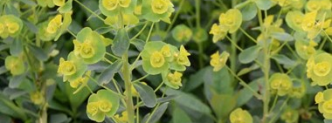

Slide 14
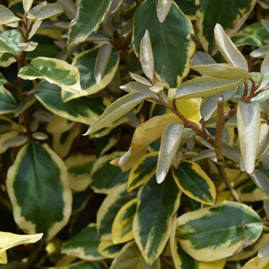
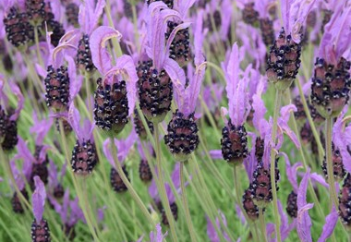
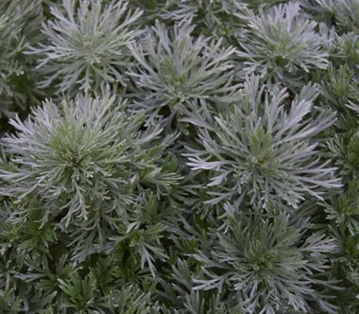
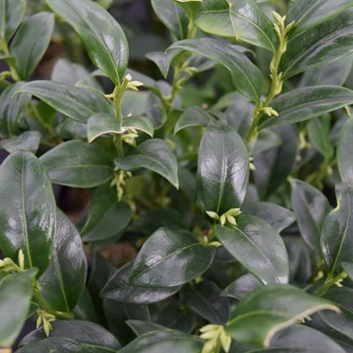
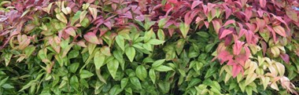

Slide 15
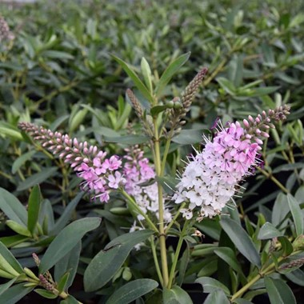
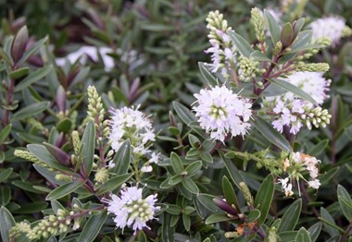
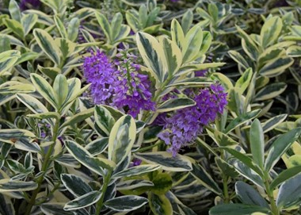
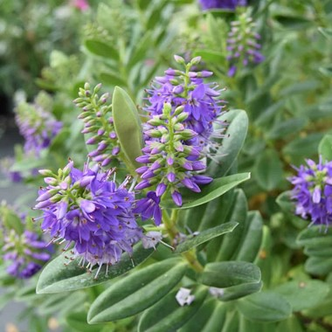
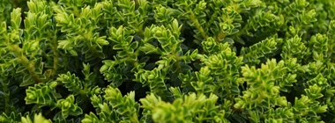

Slide 16
For consideration
Is it the plant? Or is it in the preparation?
Without doubt plants have adapted and evolved to suit the environment they are growing in.
But……….
…if we prepare and nurture right up to establishment,
will the range we are able to select from increase?
Yes
Summer 2022

Slide 17
'Planting for Drought'
Session 3
Site preparation and soil conditioners
Summer 2022

Slide 18
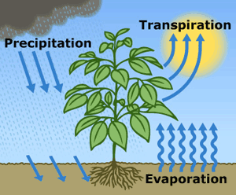
But first, how is water lost?
Knowing how water is lost from the plant and its surroundings gives us clues as to how we can prepare and maintain the planting area to reduce loss.
Summer 2022

Slide 19
It starts with the preparation
If we can create a free draining, open, aerated soil structure that holds water in suspension, cultivated to a depth to encourage the plant to develop a deeper root system, we enhance the plant’s drought resistance.
Bottom – the roots | Middle – the soil surface | Top – the plant
Some examples of how we can influence the plant’s establishment
Backfill blend | Bark mulches | Anti-desicants
Create a 'moat' | Drip irrigation | Windbreaks - Artificial
Cultivate a depth of soil | Fabric membranes | Windbreaks - Natural
Incorporate - Organic matter | Leaky pipe irrigation
Incorporate - Polymers | We will look at the products that can help with managing water in the afternoon hands-on session
Root dipping
Tree pit irrigation
Water prior to planting
We do not encourage deep rooting if we apply high volumes of water to the surface too frequently and at the wrong time.
Summer 2022
What about Living mulches?

Slide 20
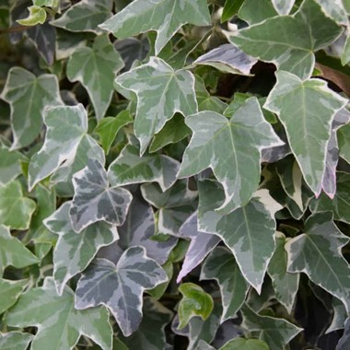
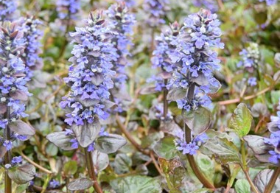
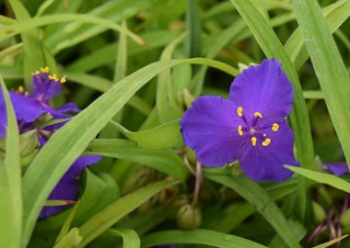
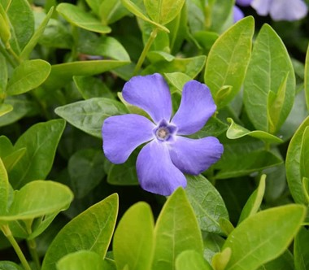
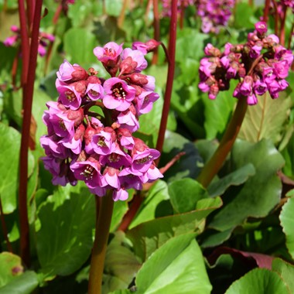
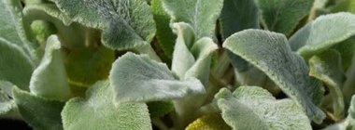

Slide 21

The function of a mulch
Artificial, living or organic mulches
deliver several common results:
Erosion control & runoff
Greater consistency of soil temperature
Reduces competition, weed suppression (unwanted plants taking water)
Reduces evaporation
Reduction in surface panning
Retention of water when drip/soaker irrigation is used
A Top Tip
Do not apply mulches when the ground is frozen or dry as this will have a negative impact on the establishment of your plants.
Summer 2022

Slide 22

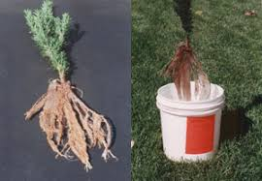
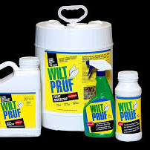
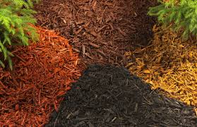

A combination of water management products can help with the establishment of the plant
‘It’s all about the roots’
Water management products
Invest to
save
Losses
Maintenance
Watering
Labour
Invest to
enhance
Appearance
Conservation
Establishment
Standards
Summer 2022

Slide 23
'Planting for Drought'
Session 4
What is ‘grey water’
Harvesting ‘rain water’
Irrigation – the basics
Summer 2022

Slide 24
What is ‘Grey Water’
A definition - The waste water from baths, sinks, washing machines, and other kitchen appliances. Grey water may contain detergents, bacteria or organic waste.
Use - With proper treatment grey water can be put to good use including toilet flushing and the irrigation of plants.
Risk - Without treatment grey water may harbour bacteria and virus or micro-organisms that can cause damage to plants. Distributing grey water through sprinklers could make bacteria airborne.
When considering harvesting and using grey water in your projects advice on how to harvest, treat and use grey water is the work of specialist companies.
Summer 2022

Slide 25
Harvesting rain water
A definition
The harvesting of rainwater simply involves the collection of water from surfaces on which rain falls and subsequently storing this water for later use.
Normally water is collected from the roofs of buildings and stored in rainwater tanks.
Is it new?
The construction and use of cisterns to store rainwater can be traced back to the Neolithic age.
Where are we today?
In some areas of the UK, and growing in importance, there is less water per head than some Mediterranean countries. This was recognised by the Government in 2006 in the Code for Sustainable Homes, revoked in 2015. The issue is still very much in focus with news releases such as that from the Environment Agency March 19.
Installations should be done in accordance with the Water Supply (Water Fittings) Regulations (including amendments plus current and future changes to legislation).
Prior to embarking on an installation, the owner of the property should consult with BS8515 and the regional service provider. The owner may need to register the installation if beyond the traditional water butt.
A Practicable Guide – The Water Butt
Summer 2022

Slide 26
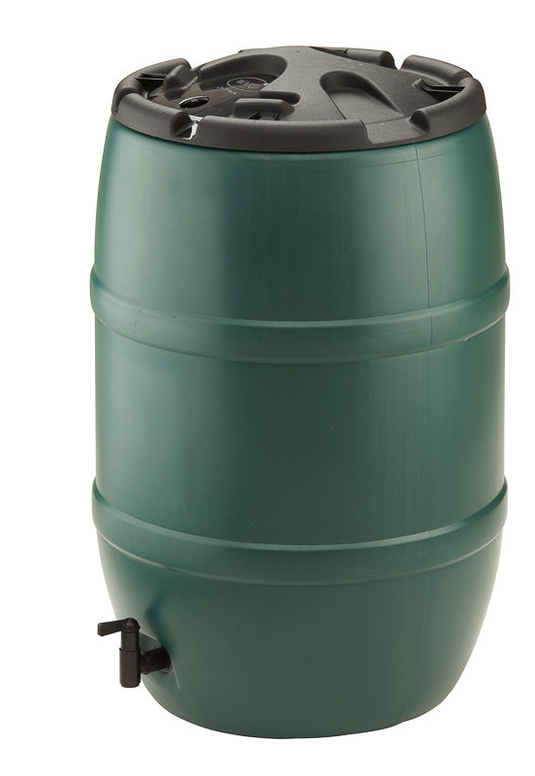
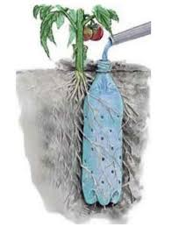
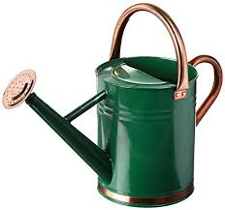
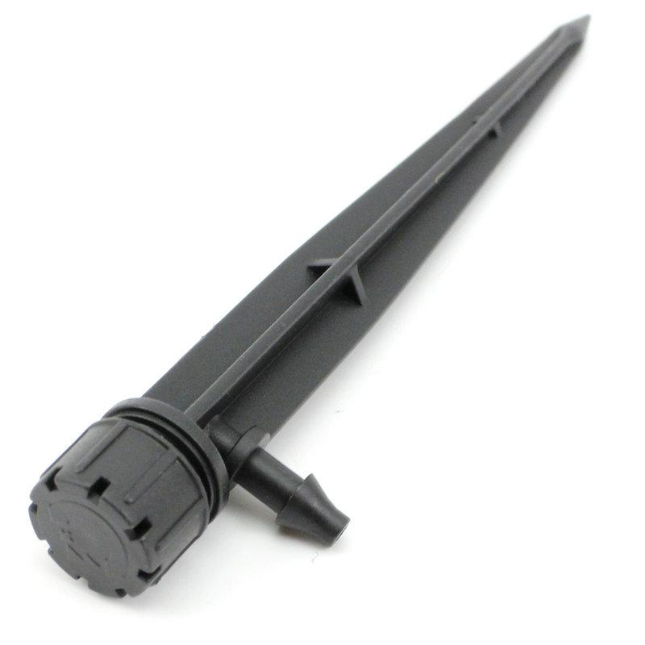
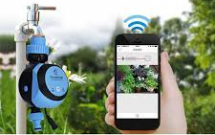
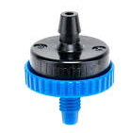
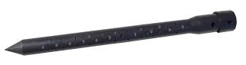
Irrigation – A direct application
The direct application of irrigation can be a simple as……..
or as complicated as……..
Summer 2022

Slide 27
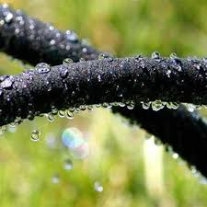
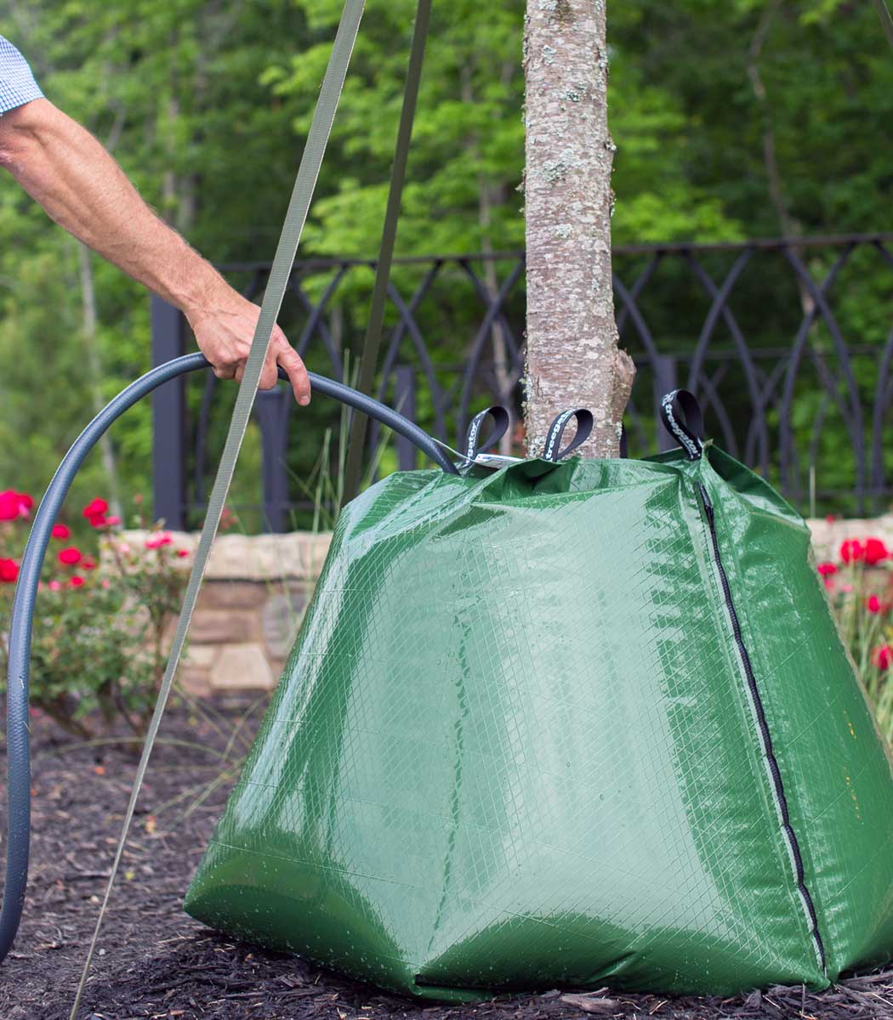
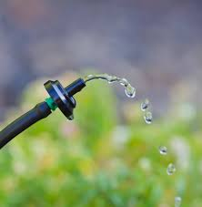


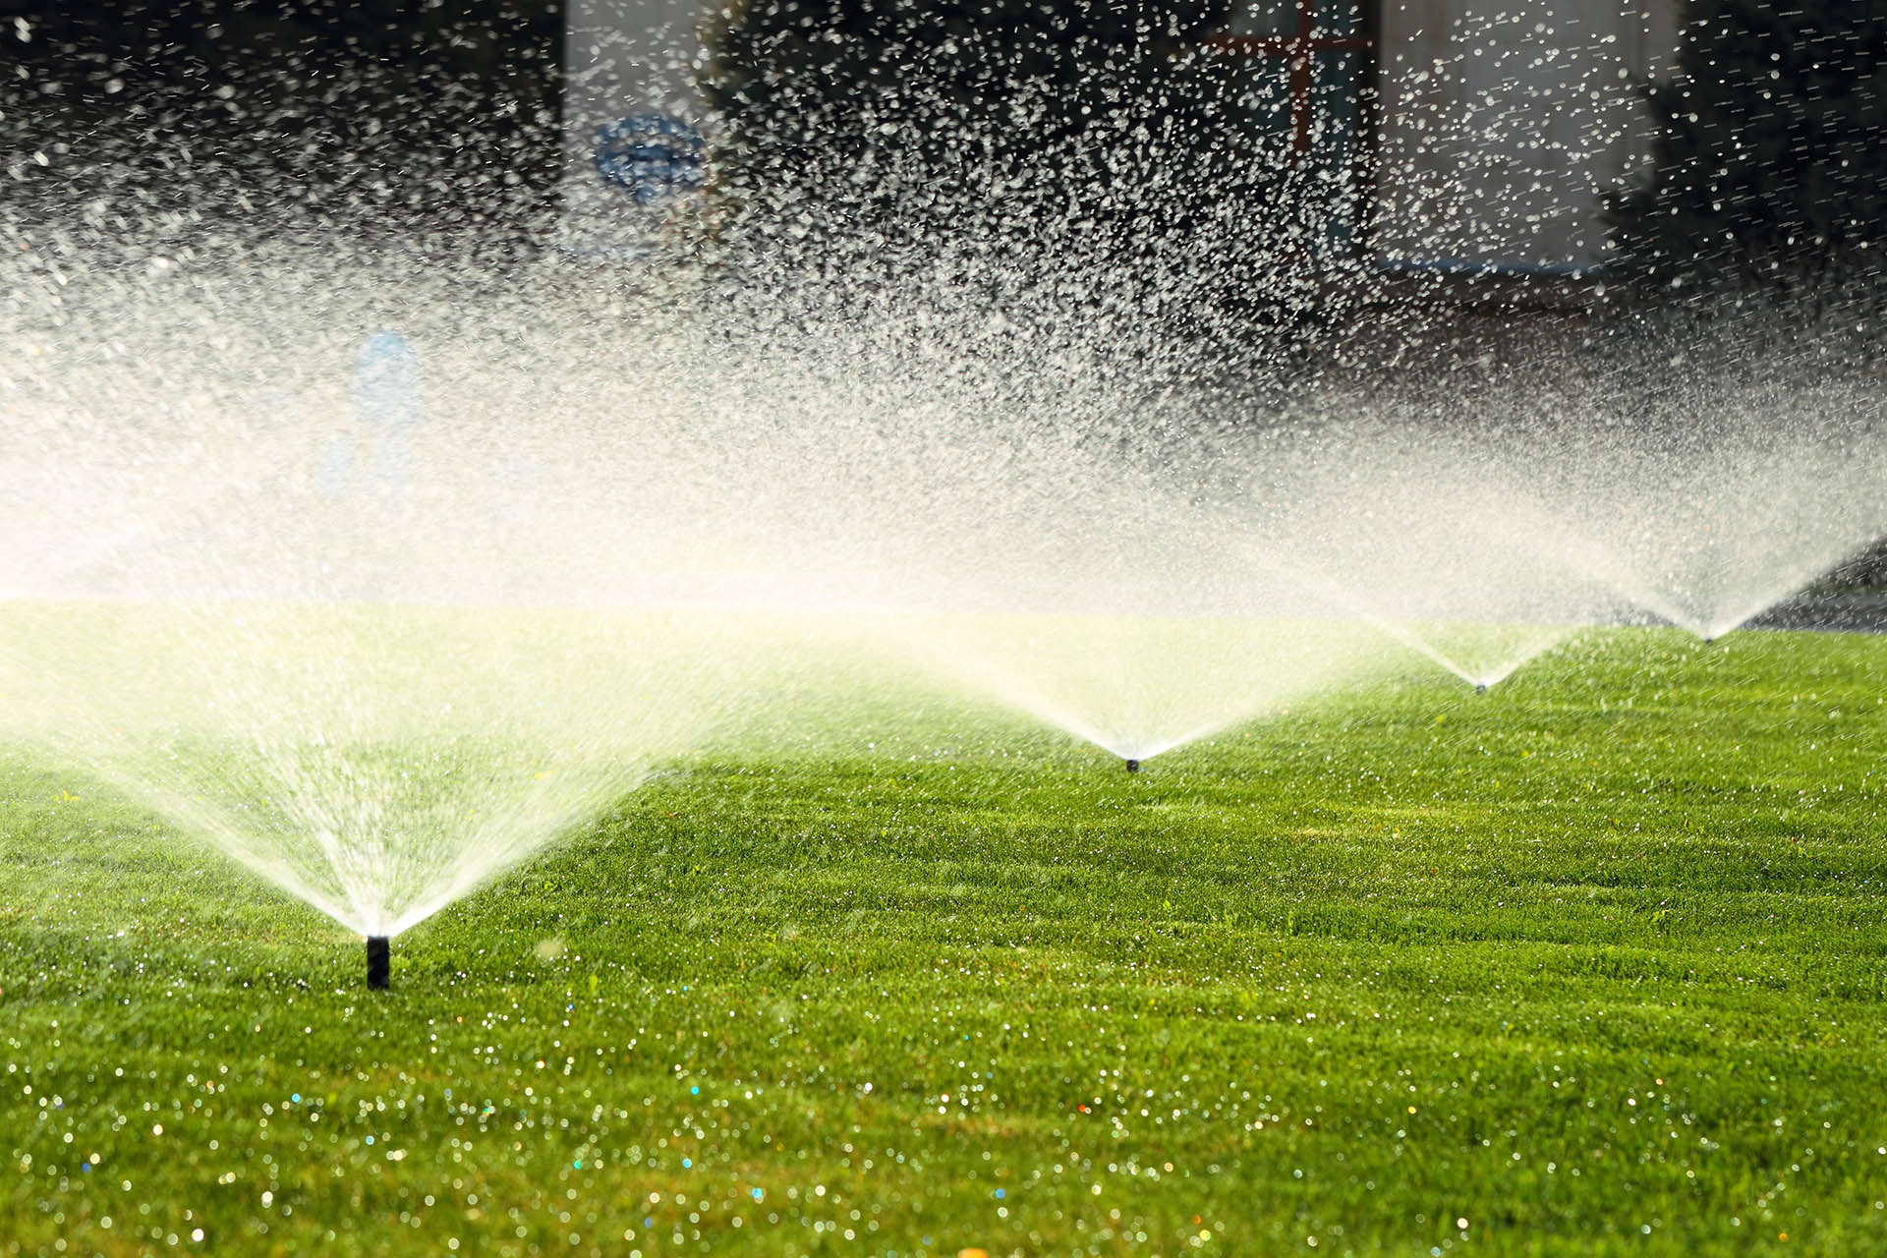
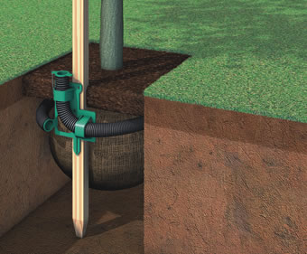
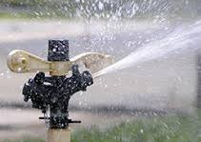
How we can apply water
Leaky Pipe
Drippers
Summer 2022
Direct application
Root Rain
Metro System
Broadcast application

Slide 28
'Planting for Drought'
Session 5
Some practicable applications to apply & reduce water consumption
It’s just about the scale
Case study – Nursery irrigation system
Applying them to your design
Summer 2022

Slide 29
'Planting for Drought'
Session 6
Looking after your designs by informing our clients
A user guide to
Managing Drought
(An end-user information handout)
Summer 2022

Slide 30
'Planting for Drought'
Session 7
Review
and
Q&A
Summer 2022

